Slide 1


Slide 2
Co-Founders:
Kesava Karri
Ankush Bosi
Ramesh Tripuraneni
Rahul Katamneni
Hardhika Venkatesan
Target Market:
Every individual and all websites related to medical field
Value Propositions:
We will be using the twitter API to get the posts related to COVID-19 from users and then we will be performing sentiment analysis on these collected posts to get the general idea of how every individual is affected by the covid crisis and how they are responding.

Slide 3
KEY WINNING FEATURES
The competitors are Rapid miner, Confirmit, IBM Watson Studio.
Stream Twitter API for live updates using Python-Tweepy.
Sentiment and Emotion analysis of tweet text using Python Textblob.
Location Plot of Tweets.
Interactive and Intuitive Dashboard.
End-to-end application deployed on Cloud.

Slide 4
CAPABILITIES
Authentication of data
Frequent data fetching
Data repetition avoidance
Polarity Distribution

Slide 5
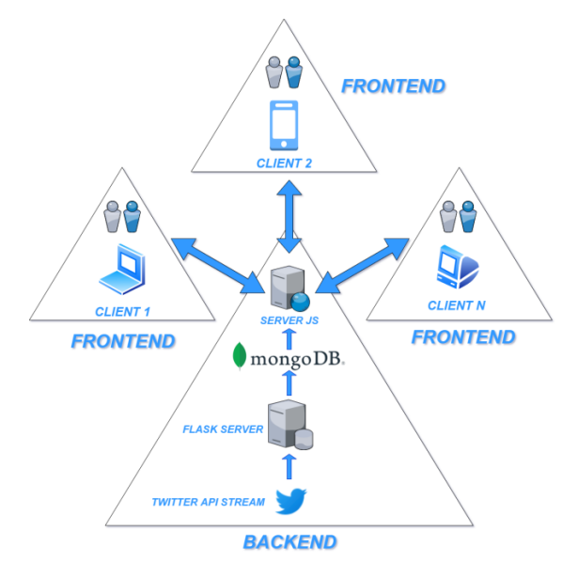
JUSTIFICATION
We will be using the twitter API to get the posts related to COVID-19 from individuals and then we will be performing sentiment analysis on these collected posts to get the general idea of how individuals are affected by the crisis and how they are responding.

Slide 6
CONCLUSION AND PLAN FOR IMPLEMENTATION
The web application's goal is to categorize tweets based on COVID. We will provide an easy-to-use dashboard with graphs, maps, and polarities. In the future, we may be able to expand our web application to handle hazardous situations.
10/20/2021 | Data Fetching & Preprocessing | Hardhika & Ankush
11/2/2021 | Front end & Backend | Rahul, Kesava & Ramesh
11/20/2021 | Front end & Backend | Rahul, Kesava & Ramesh
11/26/2021 | Dashboard Implementation & ML techniques implementation | Ankush & Hardhika
12/5/2021 | Deployment | Entire Team

